Slide 1
PBN safety assessment
APAC PBN Seminar
F.LECAT (ICAO)
10 June 2015

Slide 2
Outlines
Management of change
PBN Safety Assessment Initial Checklists: Background
First and foremost: a project framework!
Safety risk management process
PBN oversight

Slide 3
SMS Element 3.2 The management of change
ICAO Doc 9859 SMM “The service provider shall develop and maintain a formal process to identify changes which may affect the level of safety risk associated with its aviation products or services and to identify and manage the safety risks that may arise from those changes.”
A new PBN procedure, an amendment to existing procedures, or a change in the airspace are changes that
  aim at bringing more efficiency and even mitigating existing risks…
  but may also raise new risks

Slide 4
Background
PBNICG/1 in March 2015: PBN Safety Assessment Initial Checklists for RNP APCH and SID/STAR
Transitional material until ICAO global guidance material becomes available
Since PBNICG/1:
  clarification of checklist items,
  provision of reference materials,
  role distinction between safety assessor, a procedure designer and a procedure reviewer
  distinction between a new and an amended procedure
Will be proposed for adoption by PBNICG

Slide 5
First and foremost: a project framework!
Implementation matrix: 7 stages, 30 actions
Achieving measurable results
1. PROJECT PLANNING
2. DESIGN
3. SAFETY
4. COMMUNICATION
5. TRAINING
6. IMPLEMENTATION
7. POST -IMPLEMENTATION
5

Slide 6
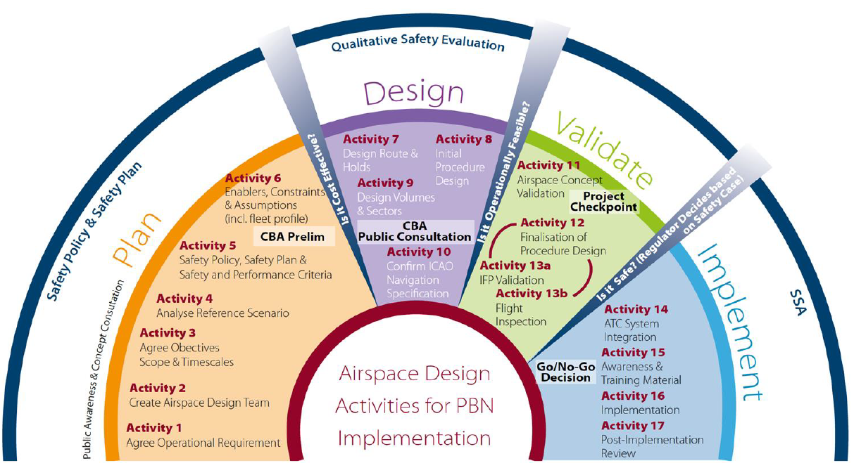
First and foremost: a project framework!

Slide 7
Safety risk management process
Should be conducted in accordance with the State/Administration SMS:
  a) the safety policy and objectives;
  b) SMS requirements;
  c) SMS processes and procedures;
  d) accountabilities, responsibilities and authorities for SMS processes and
  procedures; and
  e) SMS outputs.
Oversight by an oversight entity

Slide 8
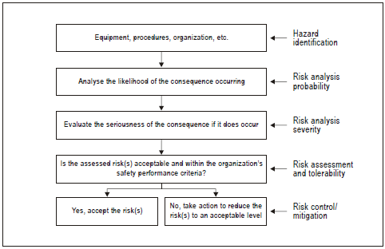
Safety risk management process

Slide 9
Draft checklists available
PBN Procedure Safety Assessment Initial Checklist – RNP APCH
PBN Procedure Safety Assessment Initial Checklist – SID/STAR
PBN Safety Assessment Initial Checklist – ATS Route

Slide 10
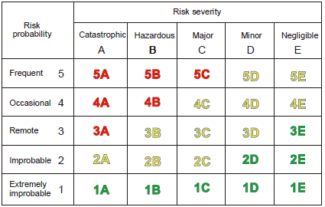
Qualitative safety risk assessment matrix

Slide 11
Safety risk assessment matrix
Unless otherwise specified by national SMS…
  Qualitative matrix could be used for a new or an amended domestic and continental ATS route.
  However, a quantitative method has to be applied when a target route is established in high seas and/or separation between aircraft or ATS routes is less than recommended in ICAO documents such as PBN Manual (Doc 9613) and PANS-ATM (doc 4444)
  Quantitative safety assessment can be assisted by sub-regional En-route Monitoring Agency (EMA) which is approved by Regional Airspace Safety Monitoring Advisory Group (RASMAG) of APANPIRG and provides airspace safety assessment, monitoring and implementation services for international airspace in the Asia/Pacific region

Slide 12
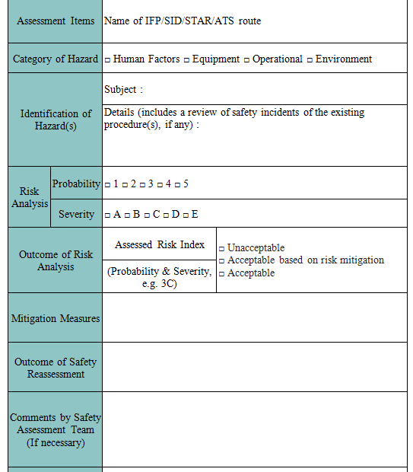
Record on Identification, Analysis and Mitigation of Hazard
(can be used if no other document is available as part of the SMS procedures)

Slide 13
Safety performance monitoring and measurement
“3.1.1 The service provider shall develop and maintain the means to verify the safety performance of the organization and to validate the effectiveness of safety risk controls.
3.1.2 The service provider’s safety performance shall be verified in reference to the safety performance indicators and safety performance targets of the SMS.”

Slide 15
PBN oversight
Regulations as basis for procedure design in accordance with ICAO PANS OPS provisions
PANS OPS inspectorate:
  functions and responsibilities, sufficiently staffed, job descriptions (minimum qualifications and experience requirements)
  training programme, periodic training plan appropriately implemented for PANS-OPS inspectorate staff
  OJT
  maintenance of training records
  Oversight office or entity (delegation possible)
  conducts oversight over its procedures specialists or service providers
  oversees the process of development and maintenance of visual and instrument flight procedures establishment of aerodrome operating minima
  minimum qualification requirements for procedures specialists and/or service providers who are responsible for the design of flight procedures
  mechanism/system with time frame for elimination of deficiencies
  periodic review of published procedure designs (changing criteria, user requirements)

Slide 16
PBN oversight (cont’d)
PANS OPS service providers
  retain all procedure design documentation (correction of data anomalies or errors found during the production, maintenance or operational use of the procedure)
  job description for its PANS OPS technical staff
  training programme for PANS OPS technical staff
  training records
  flight inspections of instrument flight procedures, including obstacle checks
  publishes obstacle clearance altitude/height
  operating minima (e.g. visibility, minimum descent altitude/height (MDA/H), decision altitude/height (DA/H)) for instrument approaches at aerodromes

